Slide 1
Staff Paid Time Off Micro Survey
Data updated: November 2024

Slide 2
Staff Paid Time Off Survey
Staff were asked to answer the following questions to gauge their perception of paid time off and their ability to use it.
The survey was sent via the Staff Council October Newsletter. Respondents represent over 25% of the distribution list.

Slide 3
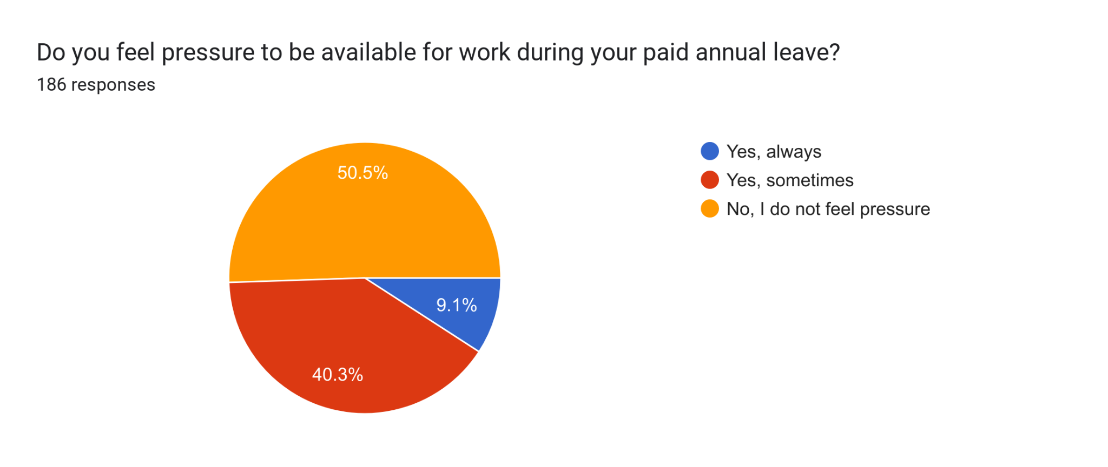
Half of the respondents always or sometimes feel pressure to be available to work during the paid leave.

Slide 4
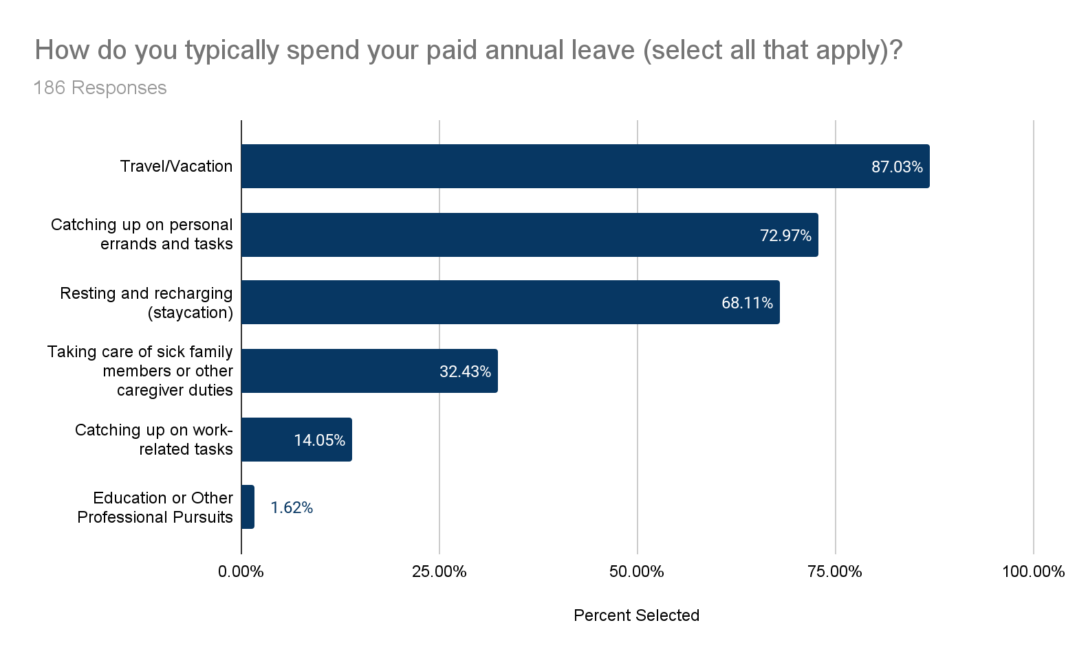
Respondents report using vacation (or annual) time off in a variety of ways including taking vacation, taking care of family members, or to catching up on work.

Slide 5
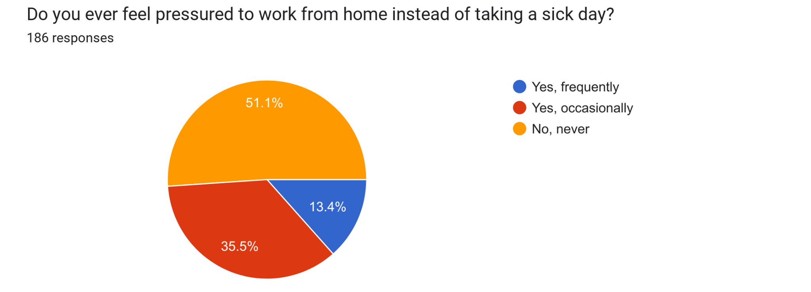
About half of the respondents report feeling frequently or occasionally pressured to work remotely rather than taking a sick day. Many of the comments note that the pressure felt is self-imposed due to concerns about work stacking up or putting extra work on teammates due to being short-staffed.

Slide 6
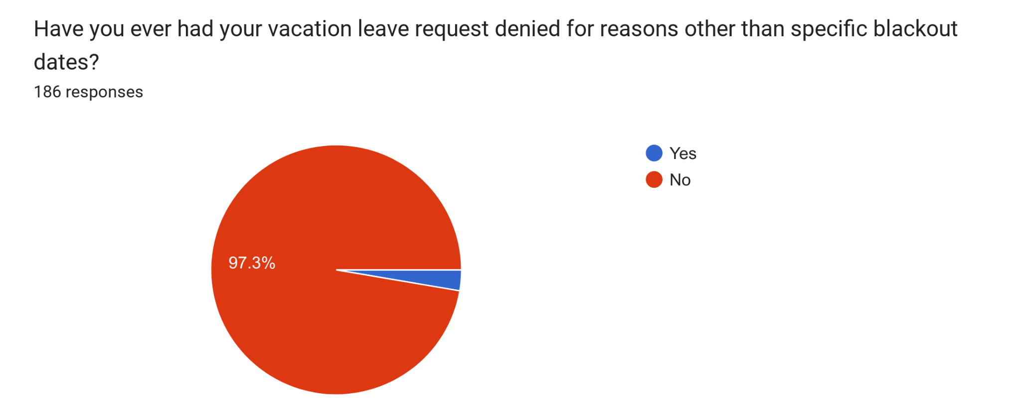
Repondants do not report having vacation (or annual) leave request denied.

Slide 7
Selection of Comments of 70+ Submitted
Used at the permission of the staff member.
“My supervisors are extremely supportive, but due to a complete lack of redundancy I feel unable to fully step away from work most of the time. I know taking time off unfairly puts extra duties on my already over-worked colleagues. I will usually log on in the morning and knock out a few things, at least! We are chronically short staffed.”
“If people know you're on vacation they shouldn't assign projects also due during your vacation. Since the pandemic, GW assumes you're fair game to work and answer emails 24/7.”
“The only way I feel I can truly disconnect is to take time off at very specific and limited times of year that are considered our slower times. If I attempt to take off outside of these unofficial slow times, it's expected that you will be reachable and working on some level.”
“I would like to express that I am not pressured by anyone in my department to work on my days off, it is only pressure I put on myself because some items need to get done.”
Comments Continued

Slide 8
Selection of Comments of 70+ Submitted
Used at the permission of the staff member.
“I enthusiastically appreciate that we can now carryover leave indefinitely, but would appreciate a reconsideration to be able to schedule leave before it's accrued again as it helps to manage anticipated busy seasons in my office for myself and as a manager of a team.”
“Vacation and sick leave is stressful because of the work that builds up while you are out. I frequently work when I do not feel good and do not take much sick leave. As a manager, the performance cycles also take a lot of time and preclude leave at some of the nicest times of the year weather-wise. If you end up taking leave, then you have to work late or on weekends to catch up in order to meet deadlines.”
“As a remote employee, I have been told that GW policy requires me to take paid leave during some in-person all staff meetings if I am unable or unwilling to pay for travel to DC out of my own pocket. My department does not have a budget for my airfare and lodging. Even when I have paid for this travel out of my own funds, policy requires that any adjacent air travel time are to be taken from paid leave if they fall during working hours. Exceptions should be made, and travel budgets created for remote workers.”
Comments Continued

Slide 9
Selection of Comments of 70+ Submitted
Used at the permission of the staff member.
“I never feel pressured to work during leave but I have no back up while out so the work just piles up while away so I voluntarily work while on leave to be less stressed when I return. It is hard to recover from sick leave when you are more stressed returning from leave since no one does it while you are out.”
“I appreciate the flexibility and amount of time off that is provided by GW. It is a huge benefit to be able to take a planned vacation or sick day when needed.”
“The new system is fine, but imperfect. There have already been issues with leave accruals interfering with family life. Options to "borrow" future leave should be on the table for extraordinary circumstances. There is still a significantly large population of employees who cannot take time without pay, and there has to be a meaningful, employee-focused policy that addresses emergencies.”
“Staff whose roles center around classes (labs, reciations, discussions, etc.) have hard time finding time to take leave, because GW operates classes consistently through the spring, fall, and summer. As someone whose role involves overseeing GAs and preparing materials for these types of classes, there is often not time to take leave when classes meet consistently throughout the year. It's also difficult to take leave while classes are running, because there's no staff support/back-up.”

